Slide 1
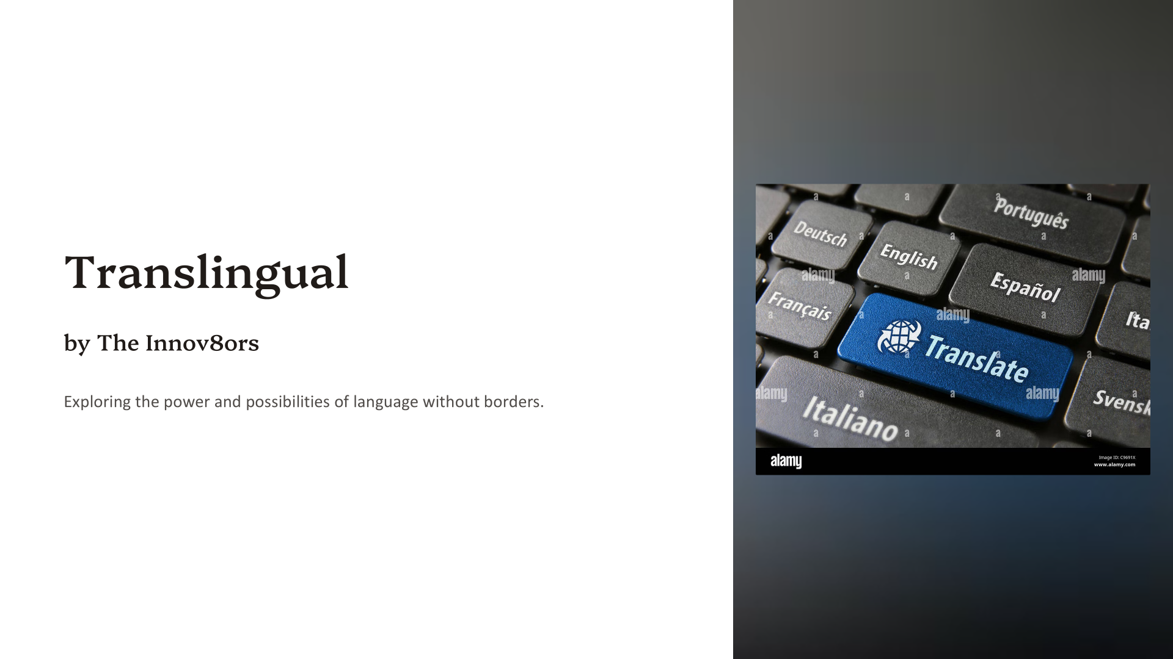
AI Avengers

Slide 2

Multi-Language Translator: Bridging the Communication Gap
In an increasingly interconnected world, language barriers pose a significant challenge. This presentation introduces a cutting-edge solution: a powerful multi-language translator designed to break down these barriers and foster seamless global communication.

Slide 3
The Problem: Challenges of Global Communication
Business Barriers
Social Isolation
Educational Gaps
Language differences hinder international deals. Misunderstandings lead to lost opportunities.
Communication issues limit cross-cultural experiences. Travel becomes difficult.
Access to information limited by language. Learning new skills is difficult.

Slide 4
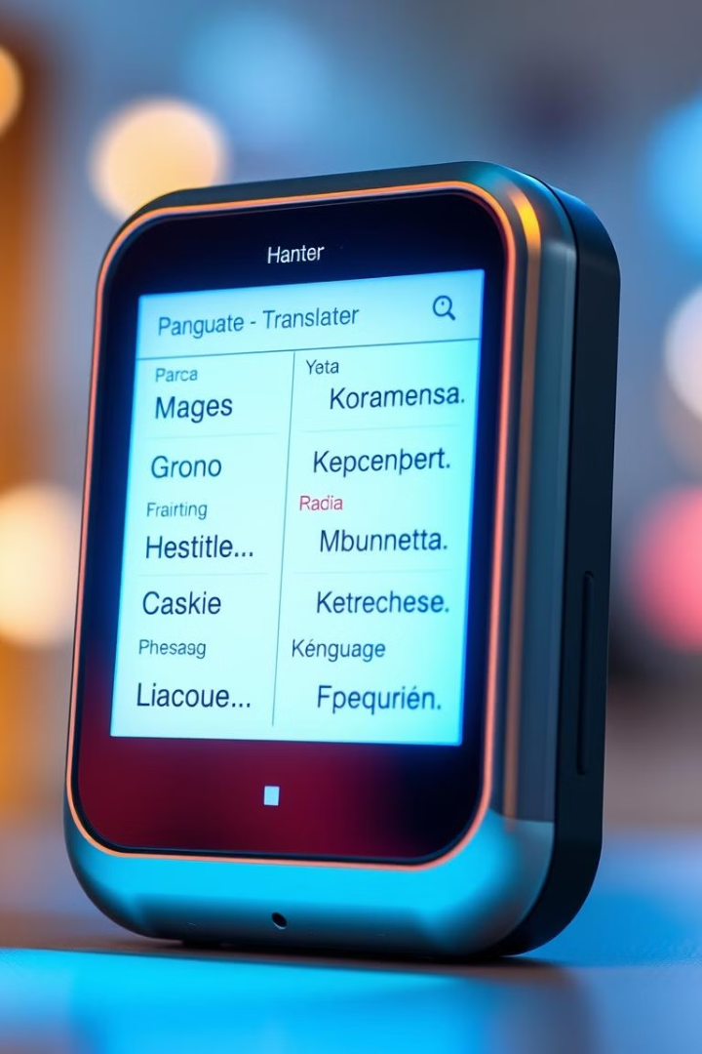
The Solution: A Powerful Multi-language Translator
1
Instant Translation
2
Cross-Platform Access
Real-time conversion of text and speech. Breaks down language barriers.
Available on computers, phones, and tablets. Use it anywhere, anytime.
3
Intuitive Design
User-friendly interface for easy interaction. No steep learning curve.

Slide 5
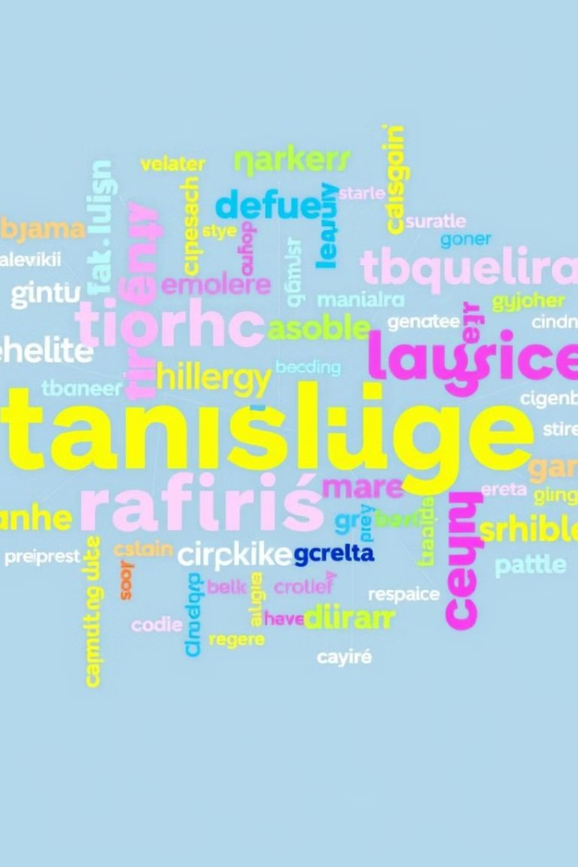



Key Features and Capabilities
Text & Speech
Global Support
Smart Learning
Translates both written and spoken words. Supports various input methods.
Offers a wide array of languages. Supports multiple dialects.
Improves translation accuracy over time. Adapts to user's needs.

Slide 6
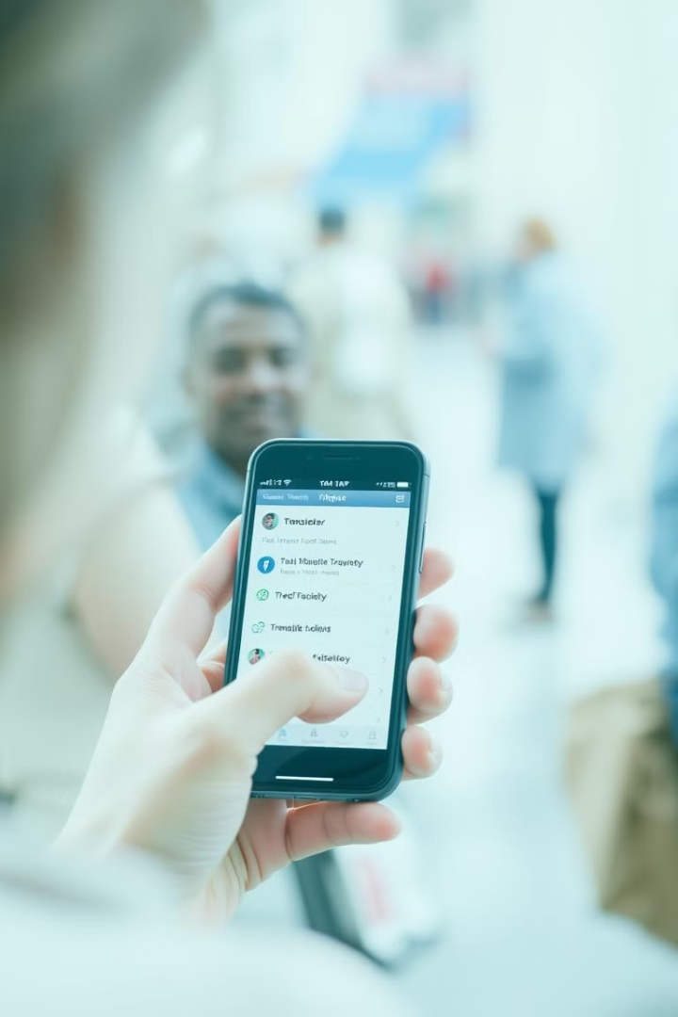



Seamless Integration Across Platforms
Mobile Apps
On-the-go translation. Perfect for travel and quick conversations.
Web Browsers
Integrated tools for online content. Translate websites instantly.
Desktop Software
Powerful offline translation capabilities. Works without internet access.

Slide 7
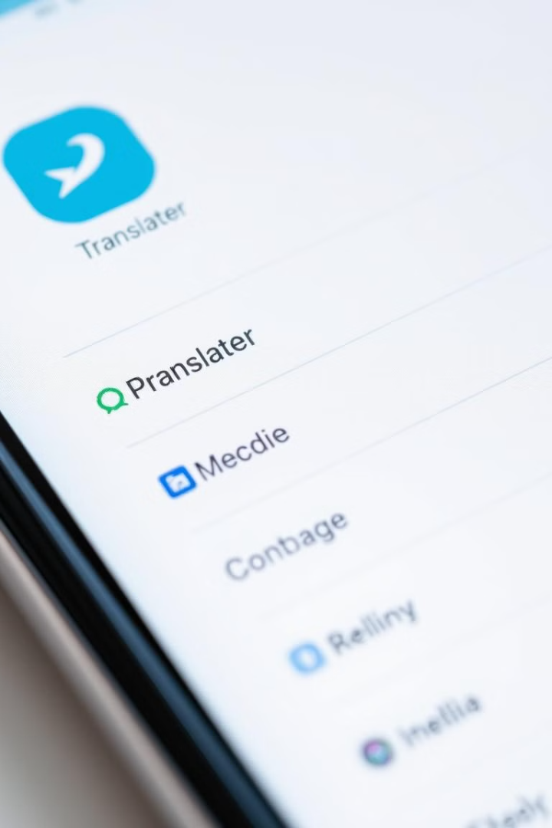
Intuitive User Interface and Experience
Easy Navigation
Customizable Settings
Simple menus and clear options. Find what you need quickly.
Adjust font sizes, themes, and language preferences. Tailor the app to your liking.
Contextual Help
Built-in tutorials and FAQs. Get help whenever you need it.

Slide 8

Advanced Language Processing Algorithms
Neural Networks
1
Understands complex sentence structures. Provides accurate translations.
2
Machine Learning
Learns from vast amounts of data. Improves over time with use.
Contextual Analysis
3
Considers the context of the conversation. Avoids misunderstandings.

Slide 9



Real-time Translation and Contextual Understanding
Context Aware
2
Understands the meaning behind the words.
Instant Conversion
1
Translates as you speak or type.
Clear Communication
Ensures accurate and effective conversations.
3

Slide 10



Multilingual Support and Continuous Expansion
Growing Library
1
Adding more languages constantly.
Global Reach
2
Connect with people everywhere.
Inclusive
3
Make communication accessible.

Slide 11

Conclusion: Unlocking the Power of Global Collaboration
Our multi-language translator empowers users worldwide. It breaks down communication barriers effortlessly. By fostering understanding, we enable global collaboration. Join us in creating a more connected, inclusive world.

